Slide 1
MODULE 2: BASELINE ASSESSMENT
Session 10: Introduction to kilojoule Calculations
Notes:
Introduction to Kilojoule Calculations

Slide 2
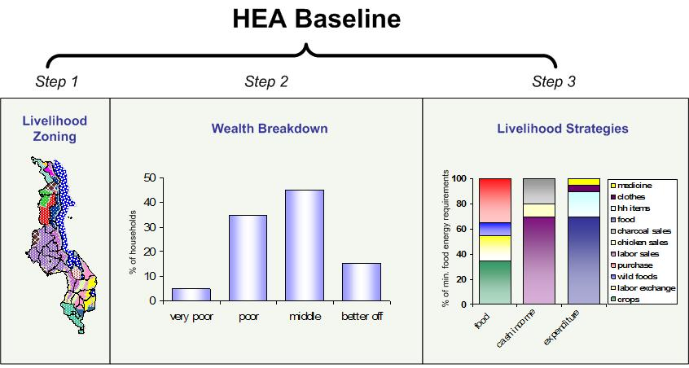
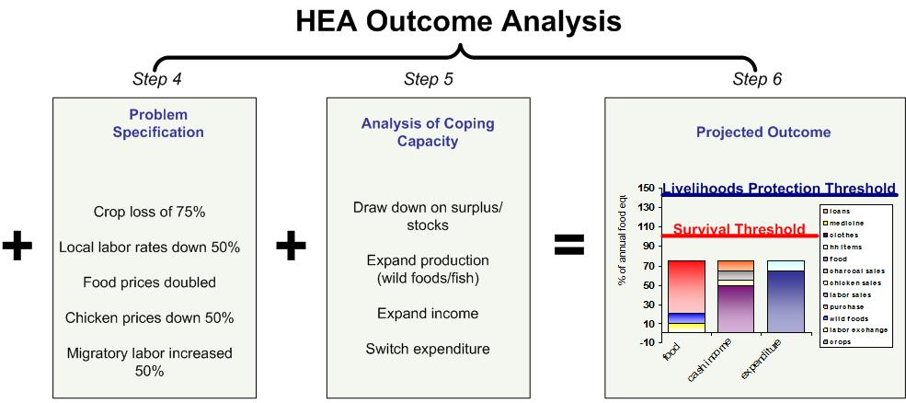
Why do we need to know about kilojoules?
We use kilojoule conversions so that we can quantify livelihood strategies and ‘add’ up food sources. This is essential in order to apply the survival and livelihood protection thresholds.
Session 10: Introduction to kilojoule Calculations

Slide 3
What are kilojoules?
joules in general science are the standard unit of heat
joules in nutrition are a measure of energy: our body ‘burns’ energy nutrients to keep the heart pumping, to keep the blood warm, and for any movement of the body
Session 10: Introduction to kilojoule Calculations

Slide 4
What are kilojoules?
The energy content of foods is usually stated in 1000-joule units: kilojoules.
Session 10: Introduction to kilojoule Calculations

Slide 5
Why are we interested in kilojoules?
We are interested in people’s access to basic food that keeps them going. This is mainly energy-food, measured in kilojoules
Balanced nutrition requires more than energy intake – it requires proteins, vitamins, minerals etc..
Session 10: Introduction to kilojoule Calculations

Slide 6
Why are we interested in kilojoules?
But the first measure of access to enough food for survival is in terms of energy, and that is the measure that HEA refers to.
Session 10: Introduction to kilojoule Calculations

Slide 7
What foods have kilojoules in them?
Virtually all foods have some kilojoules in them. But some foods have far more energy than others.
energy-dense foods include cereals, pulses, vegetable oil, ghee, butter, and sugar
Session 10: Introduction to kilojoule Calculations

Slide 8
What foods have kilojoules in them?
Leaf-crops and most fruits are good for non-energy nutrients but do not ‘fill the stomach’
Session 10: Introduction to kilojoule Calculations

Slide 9
What foods have kilojoules in them?
Apart from oil and fat, a rule-of-thumb for energy dense foods is their water content before cooking:
cereals and pulses are dry
potatoes are wet but dense with starch (an energy source)
Session 10: Introduction to kilojoule Calculations

Slide 10
What foods have kilojoules in them?
Apart from oil and fat, a rule-of-thumb for energy dense foods is their water content before cooking:
spinach, cabbage and tomato are full of water
carrots are dense with fibre, not with starch
Session 10: Introduction to kilojoule Calculations

Slide 11
kilojoule Values in Food
energy Dense |  | energy ‘Light’
Food group | kJ/kg | Food group | kJ/kg
Vegetable Oil | 37680 | Fresh Cassava | 6410
Butter | 31190 | Goat Meat | 6070
Cereals and pulses | ~14650 | Sweet Potatoes | 4770
Dry Cassava Flour | 14320 | Fresh Fish | 3980
 |  | Irish Potatoes | 3140
 |  | Milk | 2680
 |  | Dark Green Leaves | 2010
 |  | Tomatoes | 840
Session 10: Introduction to kilojoule Calculations

Slide 12
How many kilojoules do we need?
Most governments and agencies agree that the minimum, average daily energy requirement for a population is:
8800 kJ per person per day (pppd)
If a population is poor and consumes only 7950 kJ pppd, it may survive and multiply, but people will be thin.
Session 10: Introduction to kilojoule Calculations

Slide 13
How many kilojoules do we need?
If a population consumes less than approx. 7950 kJ pppd during more than a week or so they will become thinner: they are actually beginning to starve.
Remember, the requirement of 8800 is not for an individual: it is the average across a population and over time.
Session 10: Introduction to kilojoule Calculations

Slide 14
Where does 8800 come from?
Age (years) | % of pop^{n}. | kJ/day
0-4 years | 12.37 | 5400
5-9 | 11.69 | 7790
10-14 | 10.53 | 9250
15-19 | 9.54 | 10130
Males (20-59) | 24.80 | 10300
Females (20-59) | 23.82 | 8330
Pregnant |  | Add 1193
Lactating |  | Add 2090
Elderly 60+ | 7.24 | 7915
Whole pop (excl. Preg & Lact women) |  | 8670
Kilojoule requirements by age & sex (WFP/UNHCR, 1997)
Session 10: Introduction to kilojoule Calculations

Slide 15
What do kilojoules mean?
1 kJ = 0.2388 kcal ➔ 1 kcal = 4 .1868 kJ
A land rover produces 108 bhp = 80.5 kW, so to keep driving at full throttle for 1 day; you would need 80.5 x 60 secs x 60 mins x 24 hrs = 6.96 million kJ
A 200W stereo on full blast for a whole (24-hour) day burns 17,280 kJ

